Slide 1
Lecture 3 Entity-Relationship Model Constraints
Cardinality Constraints
Participation Constraints
For Ternary Relationship Sets

Slide 2
Outline
Cardinality Constraints
Participation Constraints
For Ternary Relationship Sets
Cardinality Constraints
Participation Constraints
Constraints for Ternary Relationship Sets

Slide 3
Relationship Constraints
Cardinality Constraints
Participation Constraints
For Ternary Relationship Sets
In most cases, database designers want to include some additional information about relationship sets to answer the questions like:
“how many entities can be associated with one entity at most (or at least)?”
For example, we add the relationship set “major” to model “students have majors” in the exercise of the last lecture.
But the description is not accurate.
Can one student have multiple majors?
Can one program have multiple students?
Does every student have a major?
Is every program the major for some students?

Slide 4
Relationship Constraints
Cardinality Constraints
Participation Constraints
For Ternary Relationship Sets
To express the answers, ER diagrams have constraints on relationship sets.
Constraints indicate some conditions under the context of the modeled problem.
Two types of constraints
Cardinality constraints
Participation constraints
“Cardinality” is a term from set theory. It is the number of items in a set.

Slide 5
Cardinality Constraints
Cardinality Constraints
Participation Constraints
For Ternary Relationship Sets
First, let’s consider the questions:
Can one student have multiple majors?
No, one student can only associate with at most one program as his/her major.
Can one major program have multiple students?
Yes, one major program can have many students.
This “major” relationship set is a many-to-one relationship set.
The entity set “student” is on the many side, while the entity set “program” is on the one side.
This type of constraints is called cardinality constraint.

Slide 6
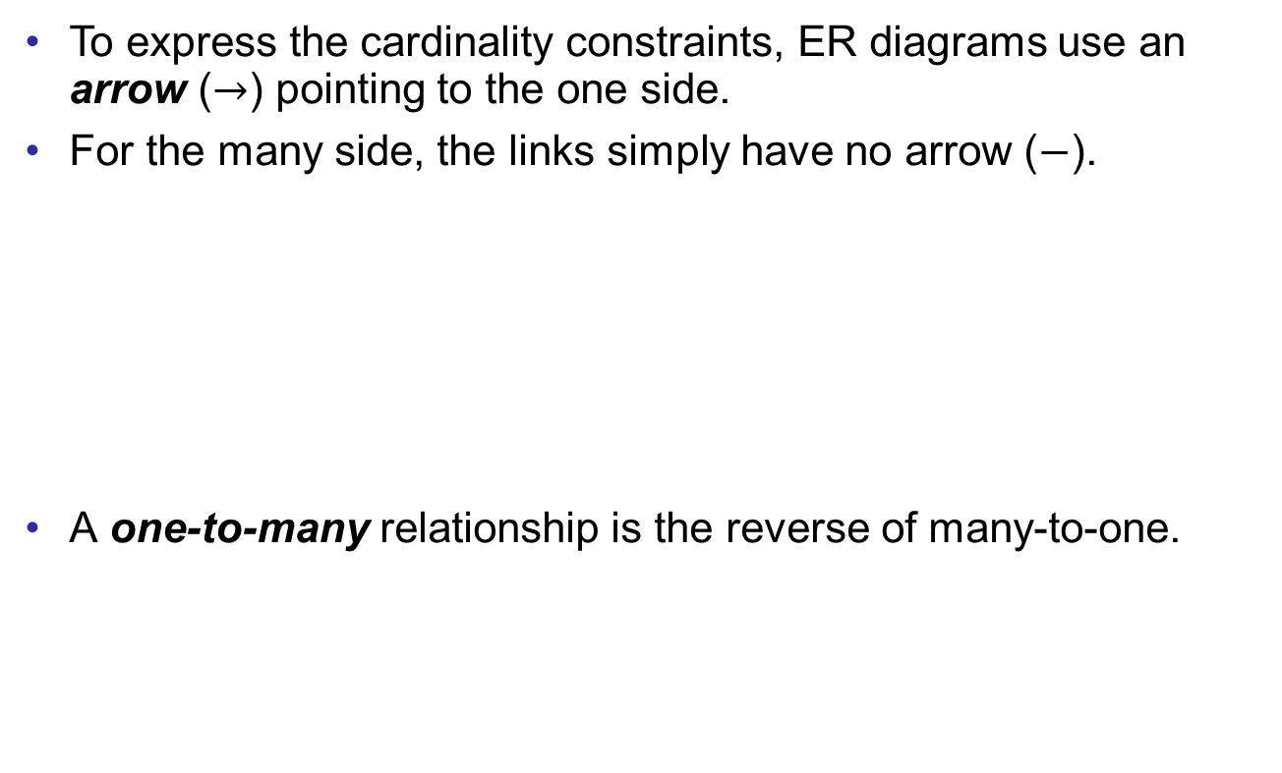
Cardinality Constraints
Cardinality Constraints
Participation Constraints
For Ternary Relationship Sets
student
major
program

Slide 7
Cardinality Constraints
Cardinality Constraints
Participation Constraints
For Ternary Relationship Sets
One-to-one relationship:
One entity from one entity set is associated with at most one entity from the other entity set and vice versa.
For example, one instructor can be the program director of at most one program, and one program has at most one program director.
instructor
program
director
program

Slide 8
Cardinality Constraints
Cardinality Constraints
Participation Constraints
For Ternary Relationship Sets
Many-to-many relationship:
One entity from one entity set can be associated with multiple entities from the other entity set and vice versa.
For example, one student can borrow multiple books, and one book can be borrowed by multiple students.
student
borrow
book

Slide 9
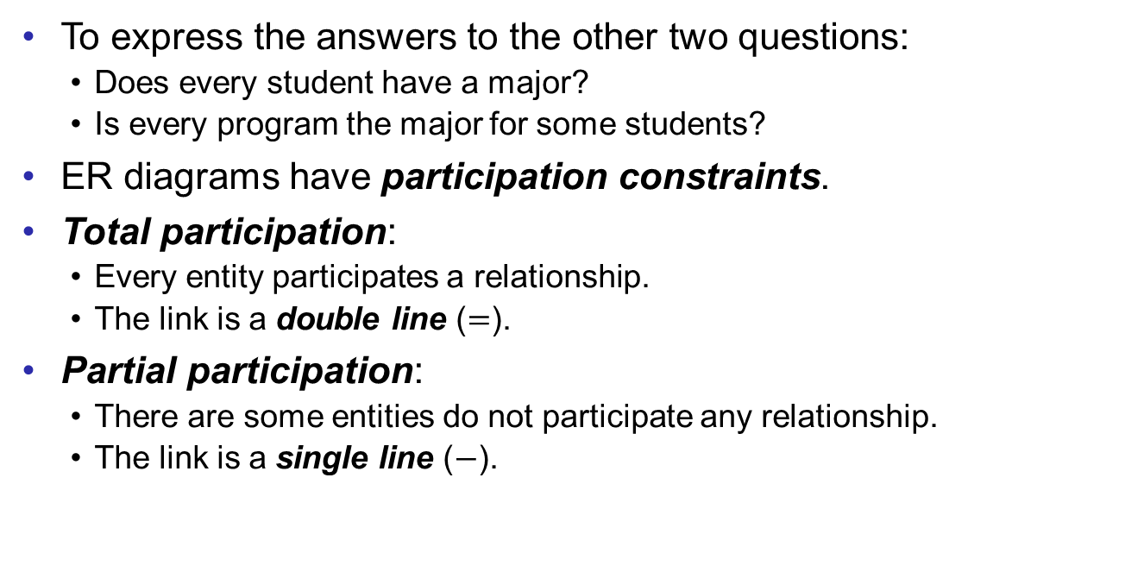
Participation Constraints
Cardinality Constraints
Participation Constraints
For Ternary Relationship Sets

Slide 10
Participation Constraints
Cardinality Constraints
Participation Constraints
For Ternary Relationship Sets
Back to the example,
Every student has a major. (Students totally participate in the relationship set.)
Every program is the major for some students. (Programs also totally participate.)
Combining the cardinality constraints,
student
major
program

Slide 11
Participation Constraints
Cardinality Constraints
Participation Constraints
For Ternary Relationship Sets
Consider another example, the relationship set “program director”.
It’s possible that an instructors is not a program director for any program.
But every program has a program director.
Thus, “instructor” is on the partial side, while “program” is on the total side.
Combining the cardinality constraints,
instructor
program
director
program

Slide 12
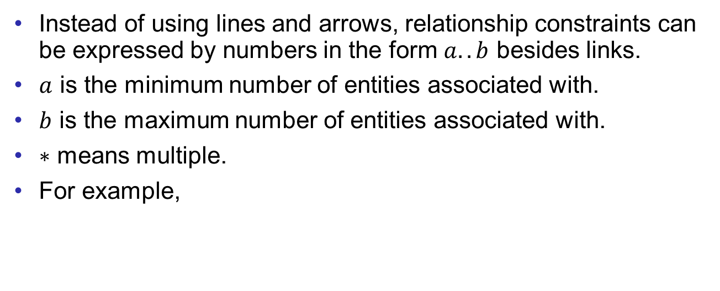



Alternative Notations
Cardinality Constraints
Participation Constraints
For Ternary Relationship Sets
student
major
program
instructor
program
director
program

Slide 13
Constraints for Ternary Relationship Sets
Cardinality Constraints
Participation Constraints
For Ternary Relationship Sets
Constraints for ternary relationship sets are not easy.
They easily creates ambiguous, meaning that an ER diagram can be understood in different ways.
Thus, we usually avoid using constraints on ternary relationship sets.
If expressing constraints is important, ternary relationship sets can always be converted into several binary ones.

Slide 14
Constraints for Ternary Relationship Sets
Cardinality Constraints
Participation Constraints
For Ternary Relationship Sets
Consider the ternary relationship “enroll” associating “student”, “instructor”, and “course”.
Assume we want to express that
one course is instructed by at most one instructor; and
one instructor instructs at most one course at a time. (Let’s just assume this for the example purpose. Even it is not the real case.)
So, both of “instructor” and “course” are pointed by arrows.
One may draw the ER diagram naively as follows.
student
enroll
course
instructor

Slide 15
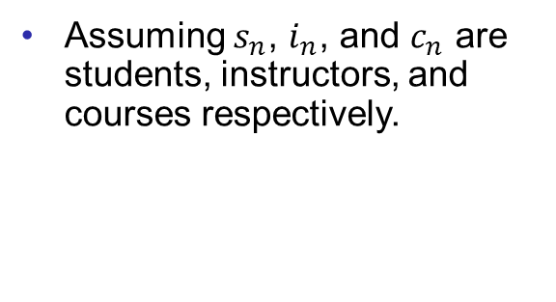
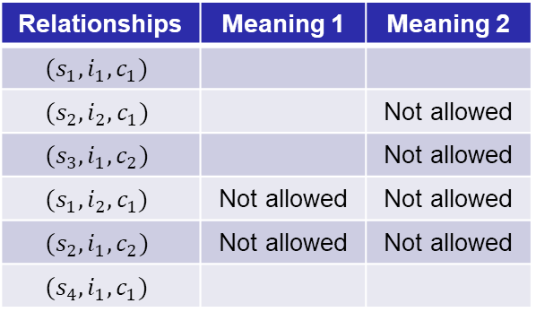
Constraints for Ternary Relationship Sets
Cardinality Constraints
Participation Constraints
For Ternary Relationship Sets
However, this ER diagram can be understood in different ways.
Meaning 1:
One student is only associated with one combination of a course and an instructor. But, no constraints is between course and instructor.
Meaning 2:
One course is instructed by at most one instructor.
One instructor can instruct at most one course.
But there is no constraints on students.
Relationships | Meaning 1 | Meaning 2
 |  | Not allowed
 |  | Not allowed
 | Not allowed | Not allowed
 | Not allowed | Not allowed
student
enroll
course
instructor

Slide 16



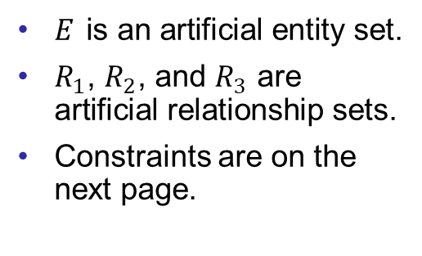

Converting Non-binary to Binary
Cardinality Constraints
Participation Constraints
For Ternary Relationship Sets
To express complex constraints on a ternary relationship, one can always convert the ternary relationship to binary ones by introducing artificial entity sets and relationship sets.
For meaning 1, one entity is associated with at most one combination of two entities.
This type of many-to-one constraints (the many side is a combination of entities) can be converted into
student
course
instructor

Slide 17
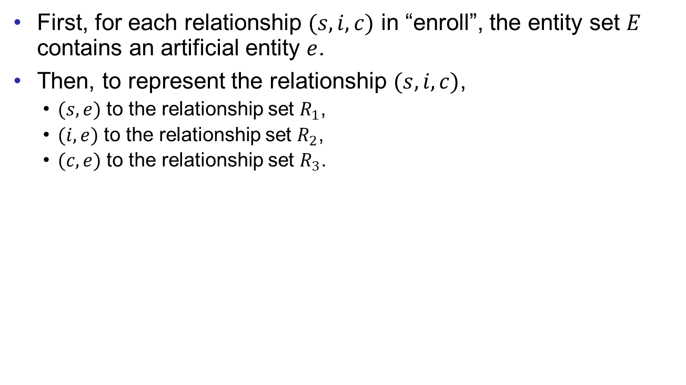
Converting Non-binary to Binary
Cardinality Constraints
Participation Constraints
For Ternary Relationship Sets
student
course
instructor

Slide 18
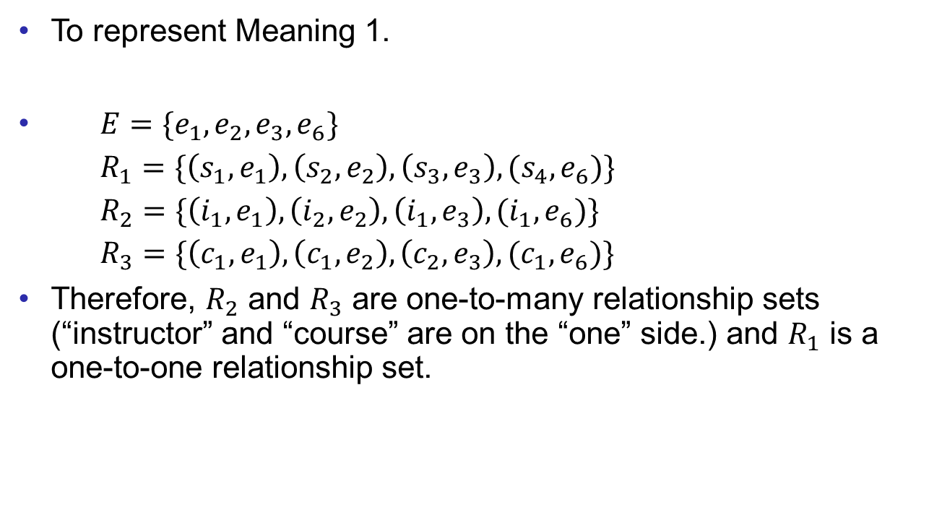
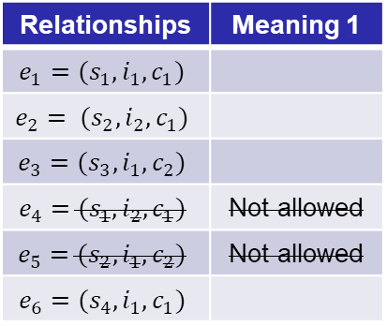
Converting Non-binary to Binary
Cardinality Constraints
Participation Constraints
For Ternary Relationship Sets
Relationships | Meaning 1
 | Not allowed
 | Not allowed
student
course
instructor

Slide 19
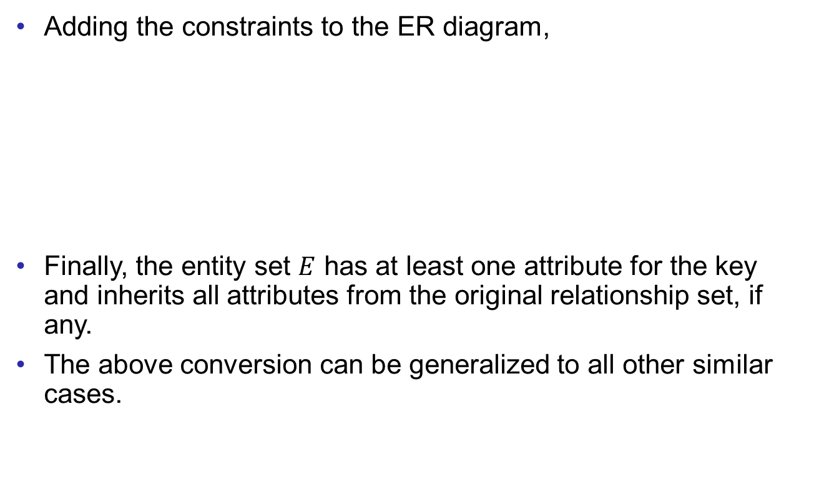



Converting Non-binary to Binary
Cardinality Constraints
Participation Constraints
For Ternary Relationship Sets
student
course
instructor

Slide 20


Converting Non-binary to Binary
Cardinality Constraints
Participation Constraints
For Ternary Relationship Sets
Next, we move on to the meaning 2.
One course is instructed by at most one instructor.
One instructor can instruct at most one course.
But there is no constraints on students.
However, the above construction does not work for this case. (Please have a try.)
This constraint is between two entity sets and free from other entity sets.
For this type of constraints, the structure is like this.
student
course
Only three relationship sets are added.
instructor

Slide 21
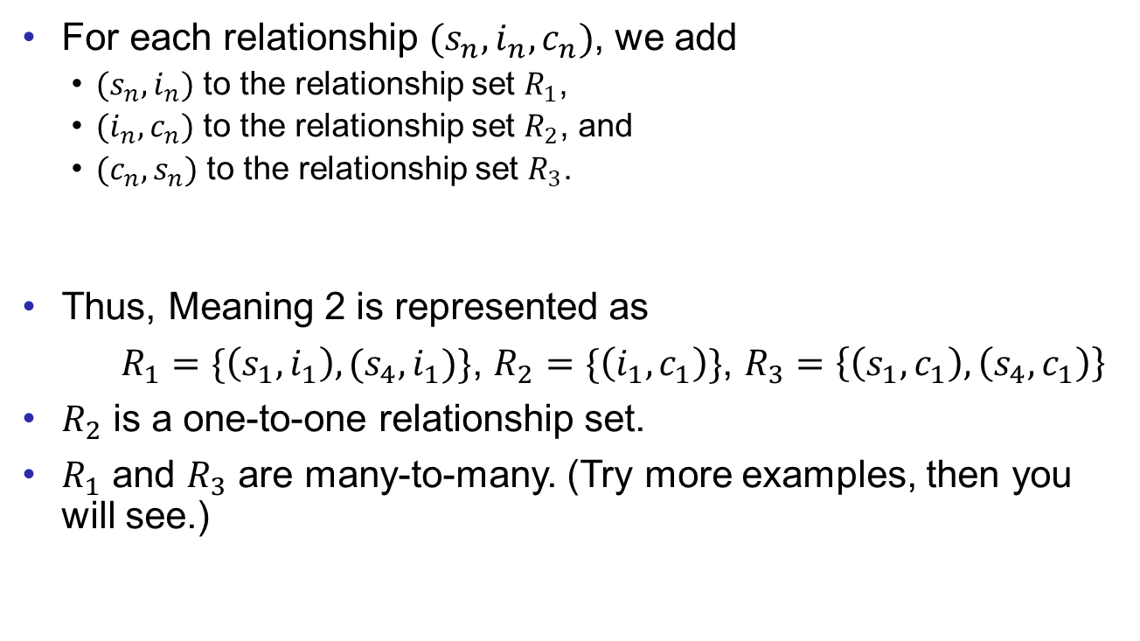
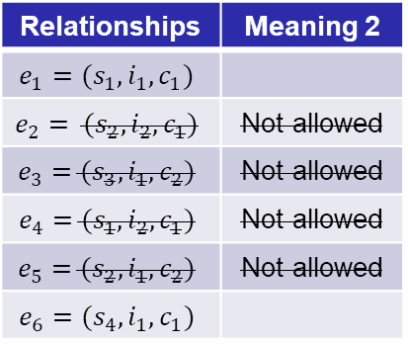
Converting Non-binary to Binary
Cardinality Constraints
Participation Constraints
For Ternary Relationship Sets
Relationships | Meaning 2
 | Not allowed
 | Not allowed
 | Not allowed
 | Not allowed
student
course
instructor

Slide 22
Converting Non-binary to Binary
Cardinality Constraints
Participation Constraints
For Ternary Relationship Sets
Sometimes more complex constraints is possible in the applications.
For example, combining Meaning 1 and 2,
One course is instructed by at most one instructor.
One instructor can instruct at most one course.
One student is associated with at most one combination of instructors and courses.
The previous conversion cannot work. (Please also have a try)
To handle this case, some extended features will be introduced in the next lecture.
We have only discussed cardinality constraints for ternary relationship sets. Participation constraints are actually the same.

Slide 23
Exercises
Cardinality Constraints
Participation Constraints
For Ternary Relationship Sets
Combining the constraints that we have discussed.
Try to make reasonable constraints on the relationship sets “major” and “PD”.
Add a new entity set “transcript”.
Model some reasonable relationship sets among “student”, “transcript”, and “course”.

Slide 24
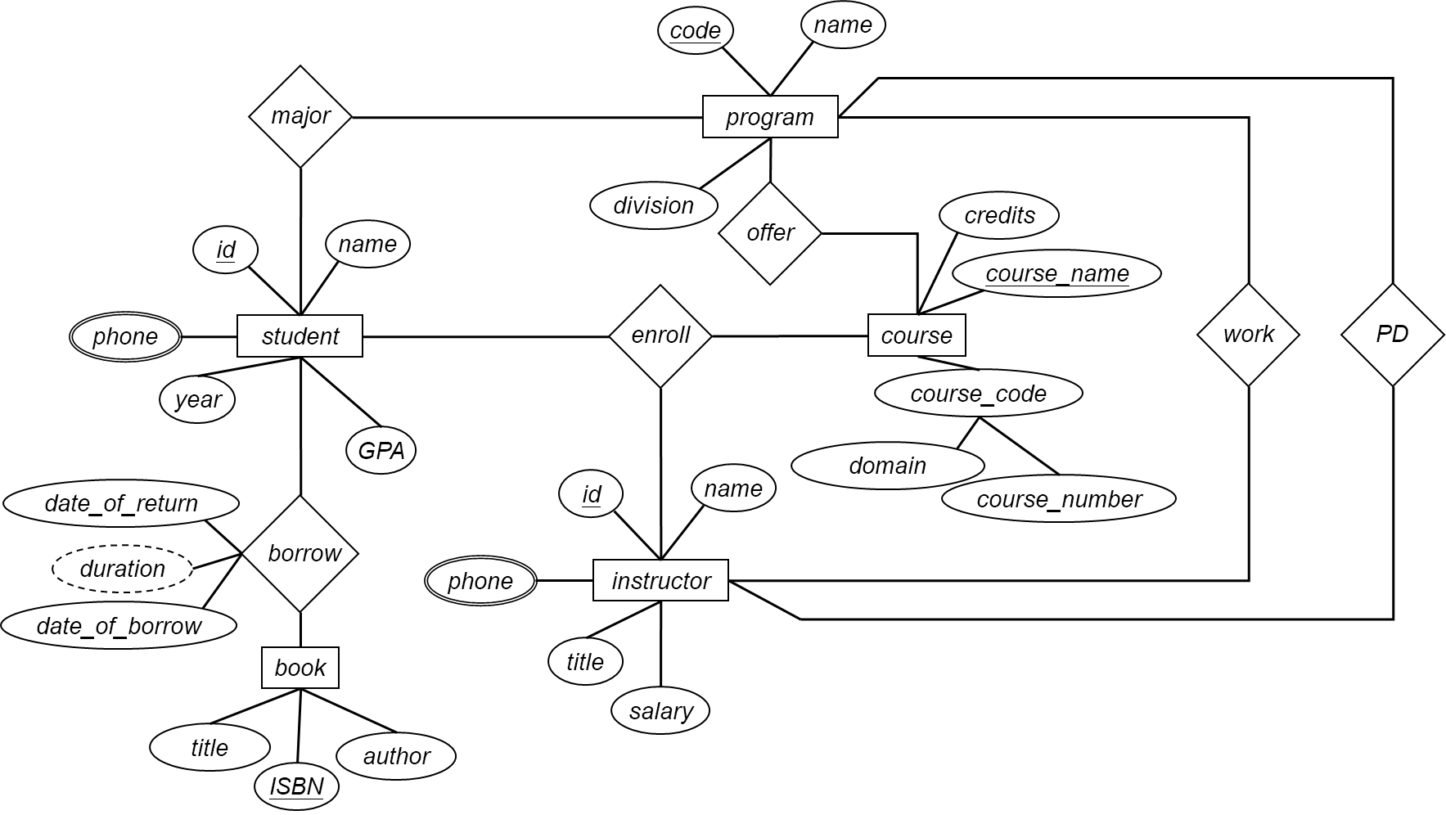
Exercises
Cardinality Constraints
Participation Constraints
For Ternary Relationship Sets

Slide 25
End of Lecture 3
Cardinality Constraints
Participation Constraints
For Ternary Relationship Sets

